Slide 1
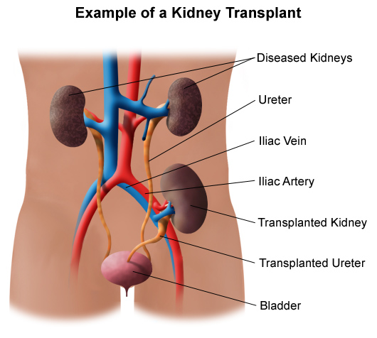
University of Baghdad
Nursing college
Kidney Transplant
Prepared by : Khadija Mohammed Jassim
Supervisor : Prof. Dr. Khalida Mohammed

Slide 2
Anatomy
The kidneys are two bean-shaped organs located on each side of the spine just below the rib cage. Each is about the size of a fist. Their main function is to filter and remove waste, minerals and fluid from the blood by producing urine.
When kidneys lose this filtering ability, harmful levels of fluid and waste accumulate in the body, which can raise blood pressure and result in kidney failure (end-stage renal disease). End-stage renal disease occurs when the kidneys have lost about 90% of their ability to function normally.
2

Slide 3
Kidney transplantation
A kidney transplant is a surgery to place a healthy kidney from a living or deceased donor into a person whose kidneys no longer function properly.
The transplanted kidney is placed in the lower belly on the front side of the body.
Types of Kidney Donor:
Living donors.
Cadaveric (Brain-dead).
3

Slide 4
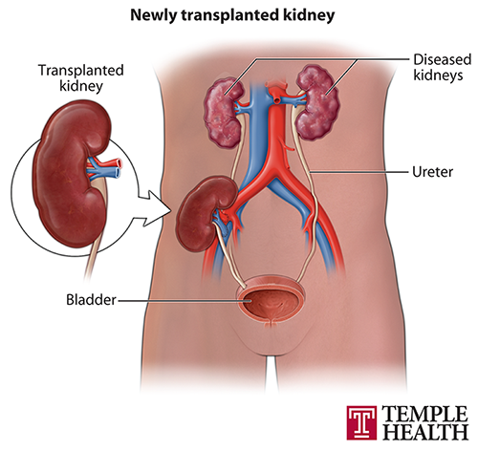
4

Slide 5
Criteria For Living Donor Selection
Blood relative.
ABO blood group-compatible.
HLA-identical, and negative Cross match.
Excellent medical condition with normal renal function.
5

Slide 6
Criteria For Cadaver Donor Selection
Irreversible brain damage.
Normal renal function appropriate for age.
No evidence of preexisting renal disease.
No evidence of transmissible diseases.
ABO blood group-compatible.
Best HLA match possible.
6

Slide 7
Patients Selection For Kidney Transplantation
All patients with ESRD are candidates for KT unless:
Systemic malignancy.
Chronic infection.
Severe cardiovascular disease.
Neuropsychiatric disorder.
Extremes of age .
7

Slide 8
Preoperative Management
Preoperative management goals include:
Bringing the patient’s metabolic state to a level as close to normal as possible through diet.
Dialysis and medical management, ensuring that the patient is free of infection.
Educating the patient for surgery and the postoperative course.
8

Slide 9
Complications of kidney transplants
Short-term complications:
Blood clots.
Narrowing of an artery.
Blocked ureter.
Urine leakage.
Acute rejection.
Infection.
9

Slide 10
Long -term complications:
Immunosuppressant side effects:
Diabetes.
High blood pressure.
Cancer .
Rejection.
10

Slide 11
Rejection
The body resists the presence of foreign cells or tissue of a donor kidney in
much the same way that it fight off bacteria and viruses which causes illness.
The rejection process occur when the patient's white blood cells reduce or stop
the function of transplanted kidney.
Some patient experience a rejection in the first few weeks after their operation.
11

Slide 12
Symptoms of Rejection
Fever.
Decrease urine output.
Fluid retention and increase in weight.
Tenderness over the kidney.
High blood pressure.
12

Slide 13
Types of Rejection
Hyper acute rejection:
Occur within minutes or hours after the transplants.
This type is very rare.it is untreatable and the kidney is removed immediately.
Acute rejection:
Occur at any time after a kidney transplants.
During acute rejection serum creatinine rises.
Usually can be treated with high doses or different type of immunosuppressive until the creatinine returns to baseline.
13

Slide 14
Chronic rejection:
This is the process can happen after kidney transplant. It can develop over
Months or years.
There is no known treatment.
14

Slide 15
Post operative nursing care
Maintenance of fluid and electrolyte balance.
Wound care.
Pain management.
Early ambulation.
Restoration of normal bowel elimination.
15

Slide 16
Follow-Up Visits After Kidney Transplant Surgery
Patient will receive a schedule of follow-up clinic visits for lab tests and
checkups.
2. The lab tests we perform monitor to:
Blood Count
Kidney Function
Electrolytes
Additional Blood Tests
Kidney Biopsy
Ultrasound
16

Slide 17
17

